Slide 1
Implementing a real - time missile Tracker
Project Under Guidance of: Dr. Rajib Jha
Rushikesh Langde 2001EE57

Slide 2
Overview
We are trying to implement a research paper, that suggests some algorithms for tracking a tank from a missile pov, to guide the missile.
Algorithm has two main components. The first, known as the primary tracker, consists of a correlation tracker. The correlation tracker begins tracking on a predesignated target.
If the primary tracker does not meet a predetermined set of conditions, the secondary tracker takes over.
The secondary tracker is a feature-based tracker in which segments corresponding to each target centroid are extracted from the IR image and various features associated with them are calculated.

Slide 3
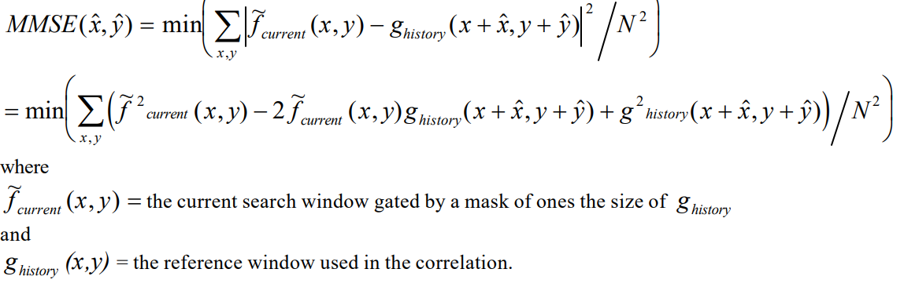
Correlation based tracker (direct approach)
Here we are considering a reference image, an input image that we will be searching in a larger search window by calculating minimum mean square error (MMSE).
By using the given formula for MMSE (in the paper)

Slide 4
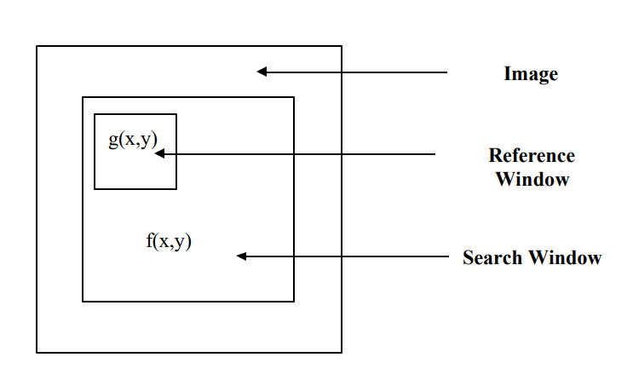
Since we are tracking from the pov of the missile which is directed towards the target (initially).
We assume that the target will be present in the central part of the search window hence we take a search window smaller that the image so as to reduce the calculations.
So as to reduce the time to process we assumed that not considering all the frames from the video would help us reduce the calculations.
Some assumptions

Slide 5
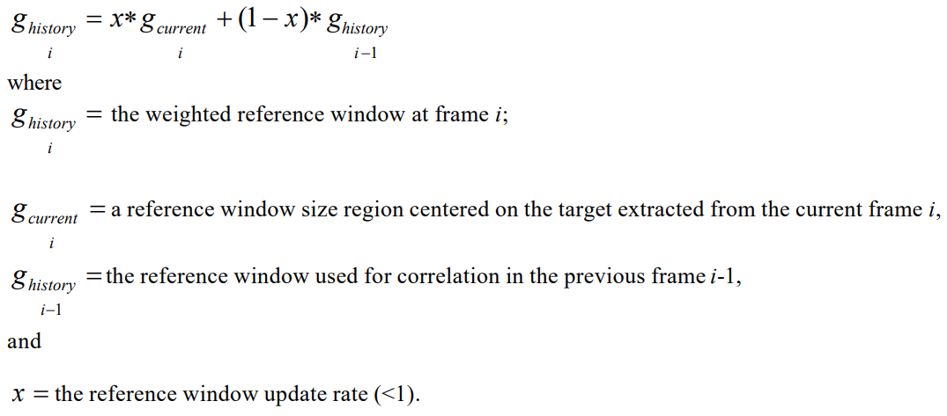
Since we are approaching the target the tank we are tracking is changing its shape with respect to the missile pov, hence we need to change the reference image after each frame so as to track the tank accurately.
Following is the modification suggested by the paper.

Slide 6
Implementation ->
https://colab.research.google.com/drive/1UKJ6N1n82ey0_oV-evB-P5ntJS9tVkT3
Now to optime this tracker further, the paper suggested to implement correlation in frequency domain with a given algorithm.
Let’s further discuss that.

Slide 7
Frequency domain based approach as per paper.
The paper suggested the following formula to calculate the MSE
To reduce the total calculations, since correlation in the spatial domain is essentially equivalent to multiplication in the frequency domain, it is often more efficient to process in the frequency domain using FFTs.
Hence the above implementation was more optimized.

Slide 8
Problems faced.
Here, we faced some problems,
since there was no accurate mention of what w1, w2, F, G, G*and M* were. (on the paper) we assumed them to be
FFTs of f and g mentioned in the MMSE, but since we had no idea what M was we neglected it in calculation of the MSE.
The formula mentioned above (MSE with FFT) suggests us to matrix multiply, we get the MMSE matrix of the size equal to the reference window.

Slide 9
We implemented the algorithm assuming w1 and w2 to be the x coordinate and y coordinate of the MSE.
But this yielded results for tracking of the first few frames only.
Further down the frames from the video the x and y of the MSE were inaccurate and random.
So now to correct it, we implemented the fft form of the tracker in a different way, using phase correlation.
Implementation->https://colab.research.google.com/drive/1LQRFUKZOmeSv-i93cV2ZPrhSfif5-G2a?usp=sharing#scrollTo=2WLIqBdgmGt0

Slide 10
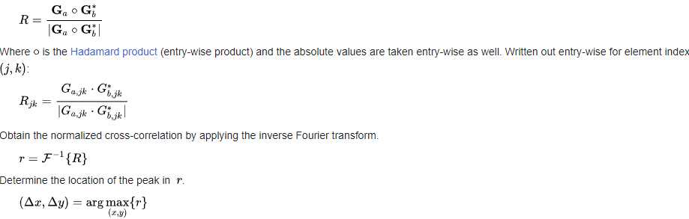
Phase correlation involves calculating cross-power specturm by taking the complex conjugate of the second result, multiplying the fourier transforms together elementwise, and normalising this product element wise.

Slide 11
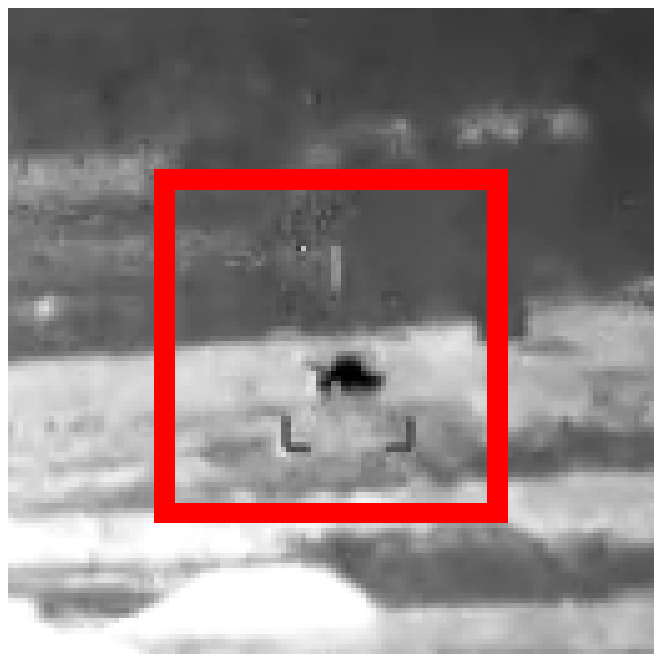
The above method was helpful in optimizing the general cross correlation method.
Now we had to implement the second tracker, for that we had to design a prescreener to extract features, from the given video image frames.
Tracking in action

Slide 12
Feature Based Tracker.
Feature based tracker when there is low when confidence level of correlation tracker drops due to some minor obstructions.
While correlation tracker is operating, prescreener provides some target centroids.
This tracker along with correlation gives the best accuracy in detecting the target.

Slide 13
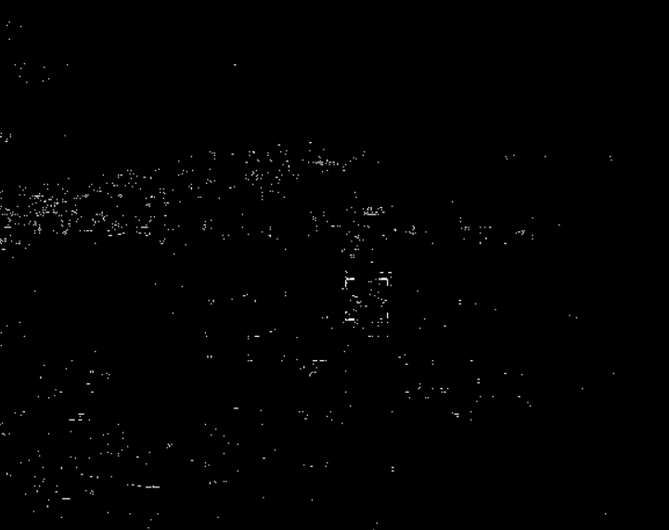
Prescreener
Prescreener is the missile target detector.
First step in the prescreener calculates strong edges in the image by applying sobel operator.
Then we Thresholded and binarized the sobel image using otsu algorithm.
Once the Integrated image has been binarized and the target centroids are calculated using morphological erode operator.
The output of prescreener will be used in the feature based algorithm.
Sobel image

Slide 14
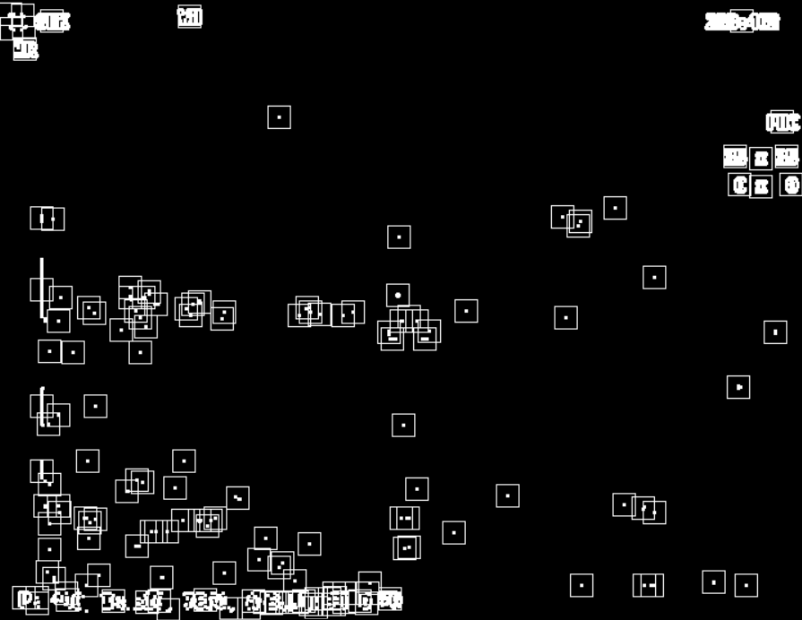
This algo works on the features of the reference image, here we have taken the mean and variance as a features.
While the correlation tracker is operating, using the output coordinates of correlation tracker a reference window has been made along with the window of each target centroids.
Calculated the mean and variance of the reference window and target centroids.
Target Centroids

Slide 15
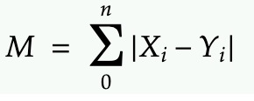
Calculating Degree of Similarity
Xi = current feature’s value of the target centroid.
Yi = reference window’s feature value.
N = No of features.
M = Degree of similarity.
The degree of similarity of a each target segment with the reference window segment is calculated.
The target centroid whose features are almost similar to reference window, which gives minimum value of
Mi is considered as a valid track.

Slide 16
Problem Faced during Implementation.
Unable to take more features of the reference window as we don’t have the proper image of tank.
During threshold and binarizing the sobel image, unable to decrease the target centroids by keeping the threshold to edge detection because tank size was too small that even with other small edges the tank was getting disappeared.
In the video the tank size was too small, so we faced difficulties while taking it as reference window because it was just considering it as dark point.

Slide 17
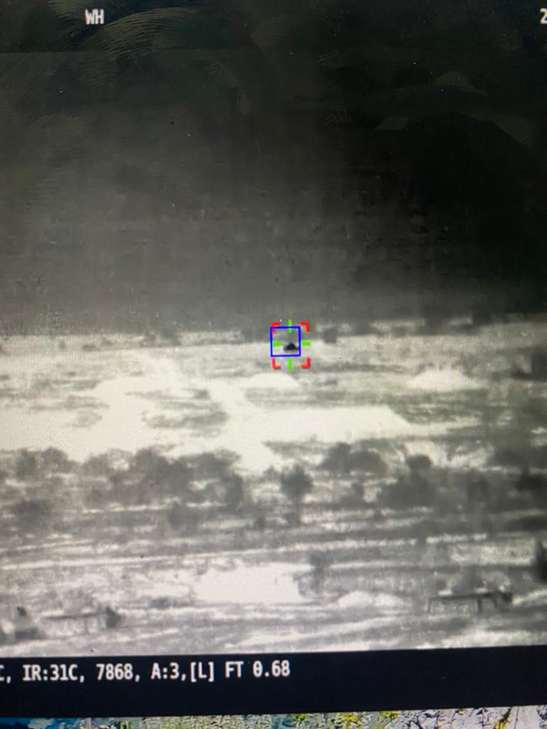
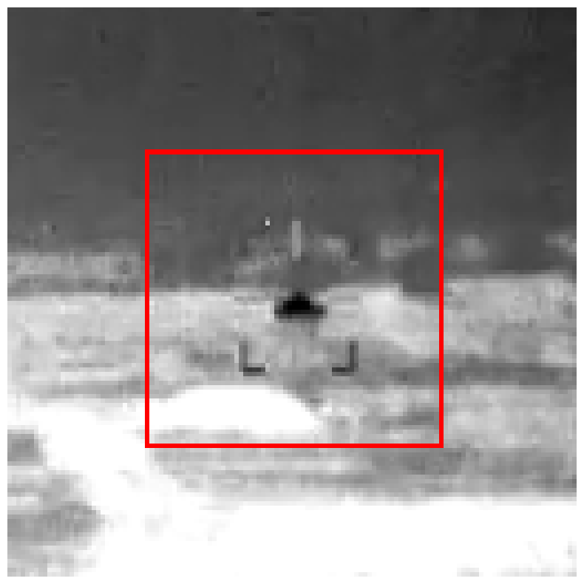
Final tracking using features
Frequency based tracker

